Slide 1


Metagenomic Data Viral Detection Tool Assessment
Sihua Peng
01/29 /2026

Slide 2

Viral Detection pipeline Assessment
Assessment scope:
CDC-listed tools
deployable alternatives/workflows
Focus:
deployability, reproducibility, evidence-chain interpretability, false-positive control
Detailed Documentations(GitHub), including usage guide line, code, selected result files, samplesheet files:
https://github.com/pengsihua2023/WasteWater-Metagenomics-Pipeline-Evaluation

Slide 3
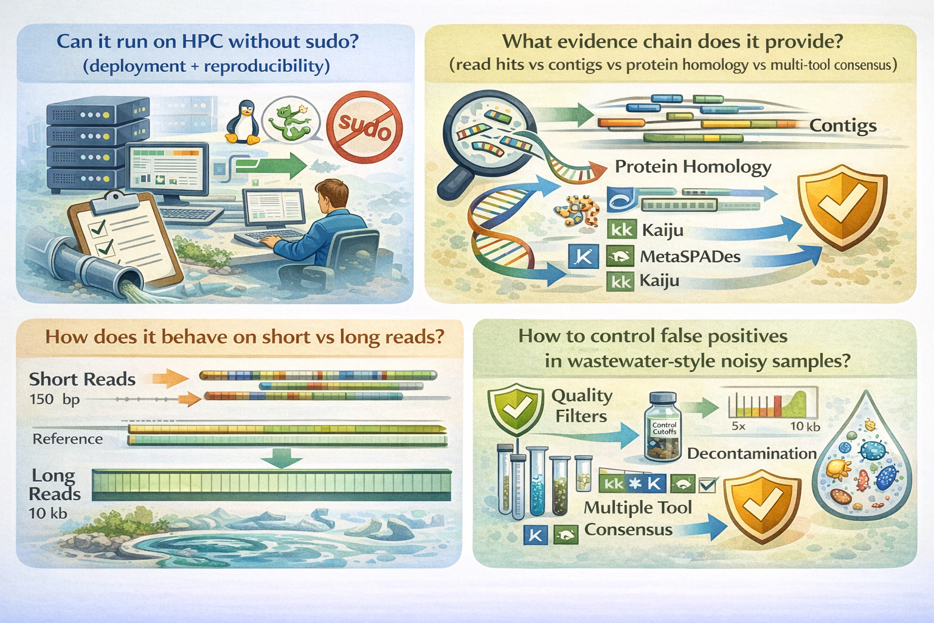
Goals:

Slide 4
Assessment Framework (Avoiding contradictory conclusions)
To prevent statements like “most sensitive and most specific” at the same time:
Default output: tool’s standard/default result set
typically higher sensitivity, higher noise
Consensus/threshold output: default output after applying rules
multi-tool cross-validation, host removal, coverage/contig thresholds, etc.
typically higher specificity, lower sensitivity

Slide 5
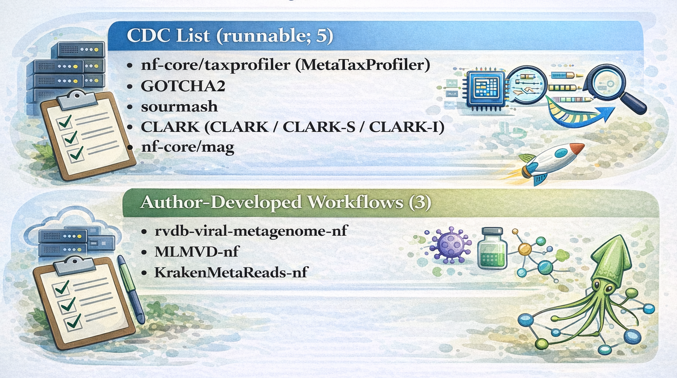
Assessment Objects (8 runnable items)

Slide 6

Non-runnable CDC items (deployment blockers)
Software | Primary blocker on HPC (no sudo / Apptainer policy)
CZID (IDseq) | cloud-first; local path not well adapted to cluster constraints
SURPI+ | requires sudo/container build patterns incompatible with HPC policy
DHO Lab | sudo/container + complex dependency chain
NAO MGS | sudo/container + complex dependency chain
TaxTriage | sudo/container + complex dependency chain

Slide 7
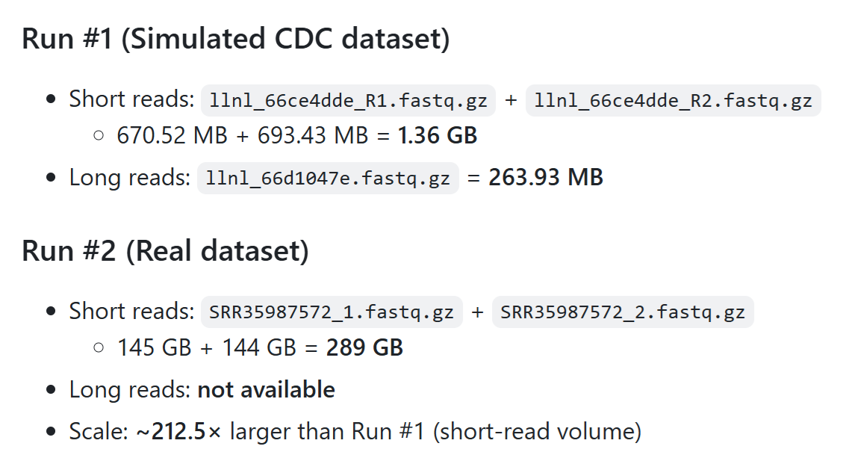
Two runs: datasets and scaling (simulated vs real)

Slide 8

Empirical compute footprint (8 pipelines, two runs)
Run | Data type | Data size | Run time (all 8 pipelines) | Peak memory (max across 8) | Main memory driver
#1 | Simulated (CDC) | 1.36 GB | ≤ 2 days | 256 GB | assembly steps typically peak
#2 | Real | 289 GB | 2–9 days | 768 GB | genome assembly software dominates

Slide 9
Four strategy archetypes (how tools generate evidence)
Direct read classification
taxprofiler; also direct Kraken2/CLARK/GOTTCHA2 usage
Contig classification after assembly
KrakenMetaReads-nf; contig interpretation from nf-core/mag outputs
Protein/alignment evidence chain
rvdb-viral (DIAMOND vs RVDB), protein-level discovery
Viral feature + multi-tool consensus screening
MLMVD-nf (VirSorter2 + DeepVirFinder + optional viralFlye voting)

Slide 10
Pipelines catalog (what is in this repository)
Pipeline | Core purpose | Assembly | Core method (1 line)
Sourmash | fast similarity/containment screening | external | MinHash sketch + gather vs NCBI viruses
MetaTaxProfiler | standardized profiling + abundance | no | Kraken2 (+ optional Bracken) + reporting
mag-nf (nf-core/mag) | genome reconstruction | yes | assembly + bins/MAG QC; optional taxonomy
KrakenMetaReads-nf | assembly-before-classification | yes | Kraken2/Bracken on contigs + RPM/RPKM
rvdb-viral-metagenome-nf | discovery via protein homology | yes | Prodigal + DIAMOND vs RVDB + taxonomy
MLMVD-nf | strict consensus candidate set | yes | VS2 + DVF (+ viralFlye long-read) voting
GOTTCHA2 | conservative confirmatory profiling | no | unique-signature profiling
CLARK | fast k-mer classification | no | discriminative k-mers (CLARK-S for long reads)

Slide 11
taxprofiler (MetaTaxProfiler): why it is the default “front door”
Best role: broad screening + rapid overview + standardized outputs
Strength: engineering maturity (nf-core/Nextflow; batch + logging + resume)
Risk: long-tail low-read hits need thresholds + validation (not “confirmed”)
Best practice: treat taxprofiler as screen-positive generator, not final truth

Slide 12
GOTTCHA2 / CLARK / sourmash: confirmatory tools (different flavors)
GOTTCHA2: high-specificity unique signatures
strong confirmation; conservative (may miss distant/low-abundance targets)
CLARK / CLARK-S: discriminative k-mers
fast; strong for in-database targets; long reads prefer CLARK-S + validation
sourmash: containment-style MinHash metrics
lightweight; good for contig-level consistency/coverage-style validation

Slide 13
Assembly-centric workflows: nf-core/mag vs KrakenMetaReads-nf
nf-core/mag:
Not a detection-first tool: primary value is MAG reconstruction + QC evidence chain
Strong when you need genome-level interpretation (coverage, completeness, contamination)
KrakenMetaReads-nf:
Assembly-before-classification (contig-level Kraken2/Bracken)
Benefits: longer contigs reduce ambiguity; good for large-virus positioning
Risk: low-abundance taxa may be lost during assembly

Slide 14
Discovery-centric workflow: rvdb-viral-metagenome-nf
Core objective: maximize discovery, especially environmental/distant viruses
Evidence chain: assembly → Prodigal → DIAMOND protein search vs RVDB → taxonomy
Strong for: long contigs + large DNA viruses (e.g., NCLDV-related signals)
Best practice: prioritize consensus sets (dual-track overlap) over single-path hits

Slide 15
Strict candidate set workflow: MLMVD-nf
Positioning: high-specificity screening via multi-tool voting
Long-read mode: VirSorter2 ∥ DeepVirFinder ∥ viralFlye (Pfam validation) → consensus tiers
Benefit: small, high-confidence list for follow-up validation
Cost: reduced sensitivity (may miss true but weakly supported contigs)

Slide 16
sensitivity vs specificity trade-off (highlevel)
Tool/Workflow | Default sensitivity | Default specificity | What improves specificity
taxprofiler | High | Medium | thresholds + host removal + multi-evidence validation
GOTTCHA2 | Medium–Low | High | signature coverage confirmation
sourmash | Medium | Medium–High | containment thresholds; contig context
CLARK (CLARK-S) | Medium | High | best for in-db targets; follow-up validation
rvdb-viral | High | Medium | consensus sets (track overlap) + additional validation
MLMVD-nf | Low | Very high | built-in multi-tool consensus
KrakenMetaReads-nf | Medium | Medium | assembly evidence + (optional) Bracken + thresholds
nf-core/mag | not detection-first | — | MAG QC evidence chain

Slide 17
False positive control: minimum required safeguards
Do not treat a detection list as a conclusion.
Minimum essentials:
Host removal
- short reads: Bowtie2
long reads: Minimap2
Threshold filtering
minimum read count / relative abundance thresholds
Interpretation rule:
single-tool only + very low abundance + no coverage/assembly evidence ⇒ Low-confidence candidate

Slide 18
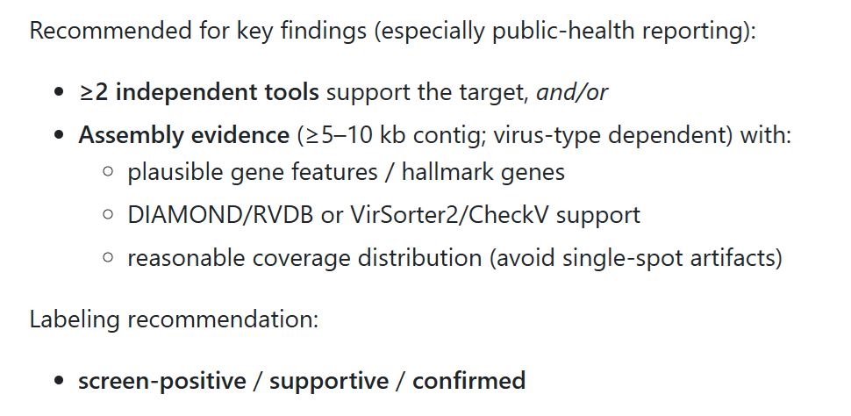
Multi-evidence chain: what “confirmed” should look like

Slide 19
Decision matrix (scores 1–5; assessment summary)
Dimension | taxprofiler | rvdb-viral | MLMVD-nf | nf-core/mag | GOTTCHA2 | CLARK | sourmash | KrakenMetaReads-nf
Known virus sensitivity (default) | 5 | 4 | 2 | 2 | 3 | 3 | 3 | 3
Distant/environmental discovery | 3 | 5 | 3 | 4 | 1 | 1 | 2 | 3
Specificity (default) | 3 | 3 | 5 | 4* | 5 | 4 | 4 | 3
Evidence-chain interpretability | 4 | 4 | 4 | 5 | 4 | 3 | 4 | 4
Speed | 3 | 1 | 2 | 1 | 4 | 5 | 5 | 3
Memory efficiency | 2 | 3 | 3 | 2 | 4 | 2 | 5 | 2
Genome reconstruction | 1 | 5 | 2 | 5 | 1 | 1 | 1 | 4
Engineering maturity (HPC) | 5 | 5 | 4 | 5 | 3 | 3 | 4 | 5
* nf-core/mag specificity is primarily driven by MAG QC evidence chains (CheckM/GUNC/coverage), not read-level classification.

Slide 20
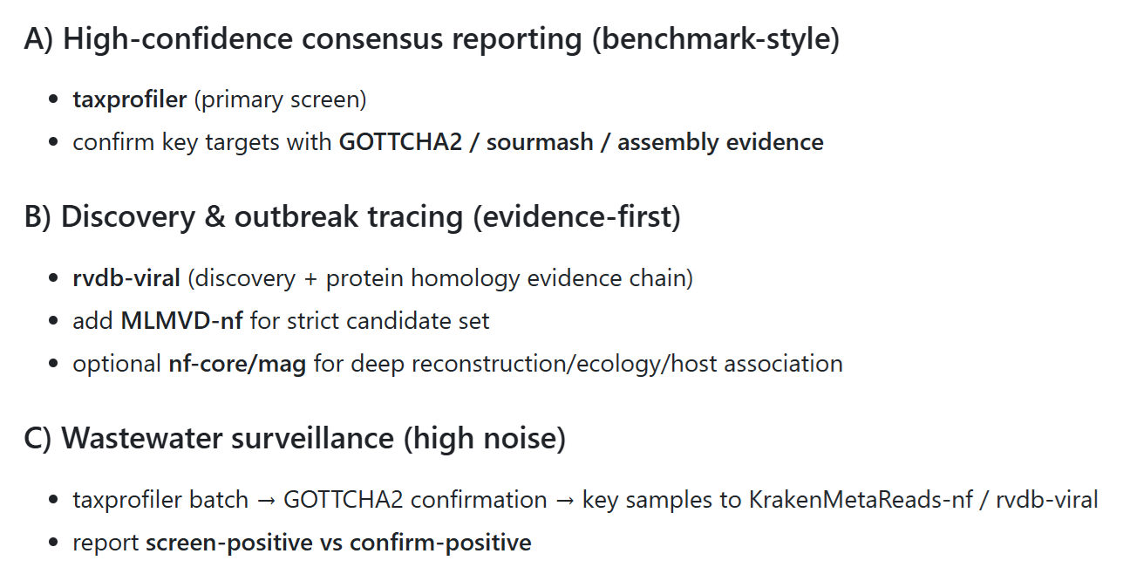
Recommended deployable solutions (decision-oriented)

Slide 21
Final conclusions
No single tool meets all needs: use layered strategy rapid screening → confirmation → deep evidence
Deployability is a hard gate for public-health operationalization
Assembly dominates compute at scale (memory/time bottleneck)
False-positive control is essential: thresholds + host removal + multi-evidence chain

Slide 22


Thanks for your attention!

